Slide 1
Garbage Collection and Memory Leak Avoidance in .NET
Yuriy Shapovalov
Senior Software Engineer, EPAM (Kharkov)

Slide 2
Agenda
Garbage Collection in .NET 4.5
How memory leaks affect enterprise applications.
Memory Leak root causes.
Memory profiling and memory leak detection tools.

Slide 3

Tracing GC algorithm
Garbage collection algorithm in .NET is based on Tracing Algorithms (McCarthy, 1960) which was developed for Lisp language.
Also known as “Mark and Sweep”
Stop all processes, run garbage collector
Trace forward from the roots
Everything touched is live, anything else is garbage.

Slide 4
Tracing GC algorithm
Every application has a set of roots:
Static variables
CPU registers
Active local variables and stack roots
roots
static
active variables
CPU registers
Managed Heap

Slide 5
Tracing GC algorithm
roots
static
active variables
CPU registers
Managed Heap
Native Heap

Slide 6
Tracing GC algorithm
roots
static
active variables
CPU registers
Managed Heap
Native Heap

Slide 7
Tracing GC algorithm
roots
static
active variables
CPU registers
Managed Heap
Native Heap

Slide 8
Tracing GC algorithm
roots
static
active variables
CPU registers
Managed Heap
Native Heap

Slide 9
Tracing GC algorithm
roots
static
active variables
CPU registers
Managed Heap
Native Heap

Slide 10
Generations
Younger objects dies faster
Older objects live longer
Garbage collection works faster for part of the heap, than for whole heap.
GLR has 3 generations:
0 – for new objects
1 – for old objects
2 – for the oldest

Slide 11
Generations
a
b
c
d
e
0
a
b
c
d
e
0
a
b
d
1
0

Slide 12
Generations
a
b
d
f
g
h
i
j
k
1
0
a
b
d
f
g
h
i
j
k
1
0
a
d
g
i
2
1
0

Slide 13
Finalization
GC can be called in following cases
Generation 0 is full
Explicit call static method GC.Collect()
Although Microsoft does not recommend to do that, sometime it make sense to force collecting.
Unload application domain.
CLR treat that application has no roots anymore.
Closing CLR
CLR tries to call Finalize() for each object in managed heap

Slide 14
Finalization
roots
static
active variables
CPU registers
Managed Heap
d
a
b
c
e
Native Heap

Slide 15
Finalization
roots
a
static
active variables
CPU registers
b
c
Managed Heap
a
b
c
Native Heap
Finalization queue
F-reachable queue

Slide 16
Finalization
roots
a
static
active variables
CPU registers
b
c
Managed Heap
a
b
c
Native Heap
Finalization queue
F-reachable queue

Slide 17
Finalization
roots
a
static
active variables
CPU registers
Managed Heap
b
c
a
b
c
Native Heap
Finalization queue
F-reachable queue

Slide 18
Finalization
roots
a
static
active variables
CPU registers
Managed Heap
c
a
c
Native Heap
Finalization queue
F-reachable queue

Slide 19
Finalization
roots
a
static
active variables
CPU registers
Managed Heap
a
Native Heap
Finalization queue
F-reachable queue

Slide 20
Problems in highly available systems
Memory leak consume available memory space on the server.
It might take one hour or a month.
Sometimes there is only one way to live with this problem – scheduled regular server reboot.
Memory
Memory
Application Available Memory
Application Available Memory

Slide 21
Performance decrease
Physical Memory
Fast Memory.
Virtual Memory
Much slower memory. Using when physical memory is not enough.
Memory
Physical Memory
Virtual Memory
Application Memory

Slide 22
Performance decrease
Physical Memory
Fast Memory.
Virtual Memory
Much slower memory. Using when physical memory is not enough.
Memory
Physical Memory
Virtual Memory
Application Memory

Slide 23
Performance decrease
Garbage Collector know that there are too less memory left, so it increase garbage collection procedure up to 50 times.
But it does not help, because leaked memory objects are not reachable for GC.
Memory
Physical Memory
Virtual Memory
Application Memory

Slide 24
Memory Leak Types
Memory leak in managed heap
Unintended reference keeping managed object alive
Memory leak in unmanaged heap
Resource disposing omitting

Slide 25
Memory Leak in Managed Heap
Memory leak in managed heap
Unintended reference keeping managed object alive
Aggregating object references
Delegates (closure context variables)

Slide 26
Memory Leak in Unmanaged Heap
Memory leak in unmanaged heap
Resource disposing omitting
Managed Heap
Native Heap

Slide 27
Profiling Tools
MemProfiler (SciTech Software)
http://memprofiler.com/
dotTrace Memory (JetBrains)
http://www.jetbrains.com/profiler/
ANTS Performance Profiler 8 (Redgate)
http://www.red-gate.com/products/dotnet-development/ants-performance-profiler/
WinDbg.exe + SOS

Slide 28
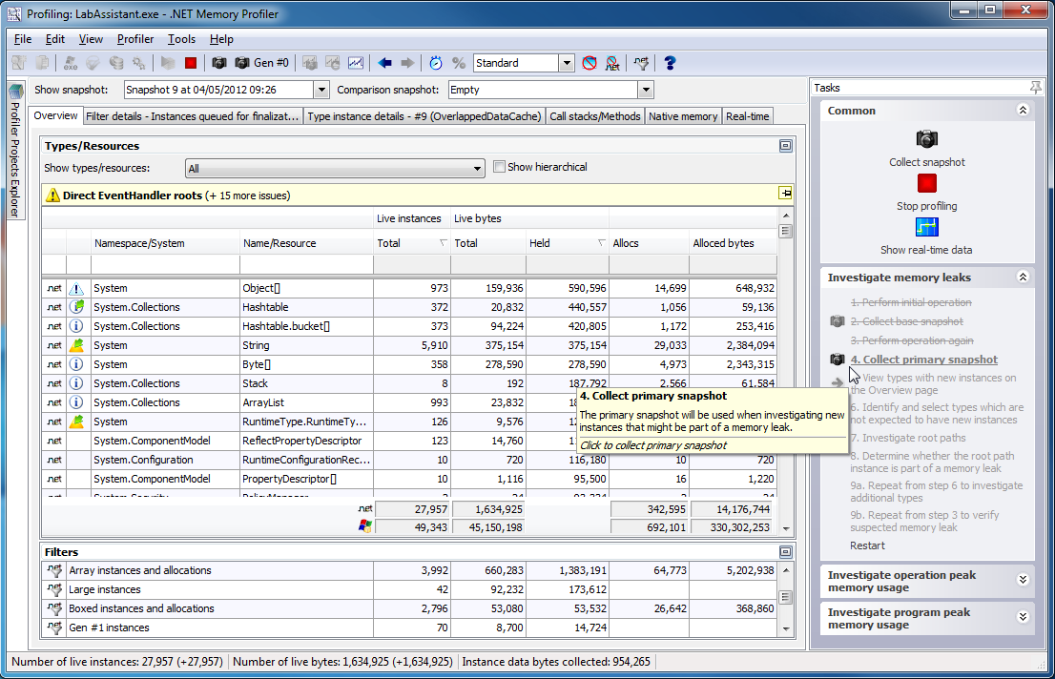
Profiling Tool: MemProfiler
Highly focused on memory profiling and leak detection.
Rich User interface.
Can work on production server and generate reports.

Slide 29
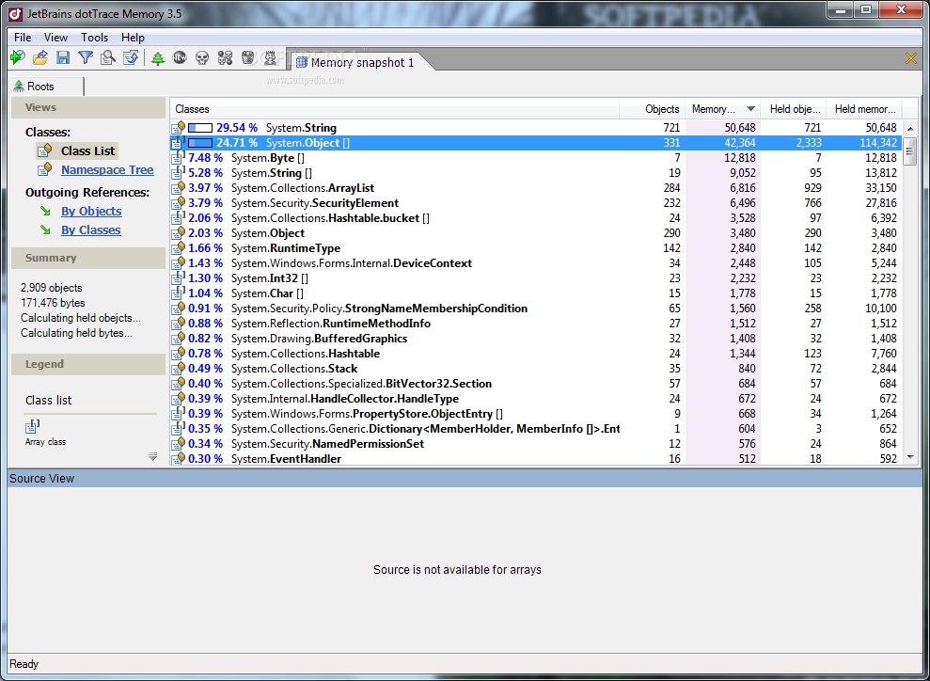
Profiling Tool: dotTrace Memory
Very convenient data representation, easy to use.
Provide referencing to source code which is cause memory leak.

Slide 30
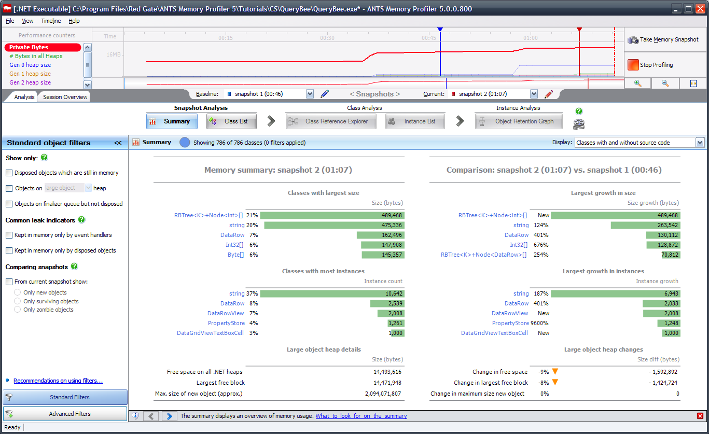
Profiling Tool: MemProfiler
Many useful features for memory consumption, and performance analysis.
Have data access profiling in latest version.

Slide 31
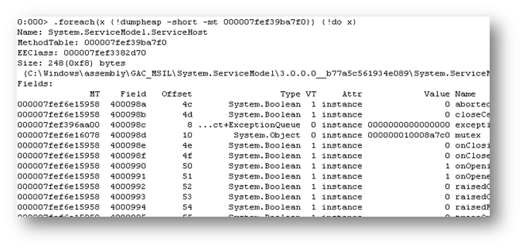
Profiling Tool: MemProfiler
Easy and free.
Integrated in Visual Studio
Command based interface.
Good for quick initial memory profiling.

Slide 32
Yuriy Shapovalov
Senior Software Engineer, EPAM (Kharkov)
yurii_shapovalov@epam.com
shapovalov.yuriy
linkedin.com/in/yuriyshapovalov
@YuriyShapovalov

